Slide 1
Advanced Traffic Simulation System
Real-World London Road Network Analysis
with Multi-Algorithm Routing
Progress Report - August 2025

Slide 2
Project Overview & Objectives
Primary Objectives
Develop comprehensive traffic simulation using real London street network
Compare multiple routing algorithms under varying congestion scenarios
Implement realistic traffic flow modeling using queuing theory
Create interactive visualization and analysis tools
Key Research Questions
How do different routing algorithms perform under varying traffic conditions? (Stress Test Involved)
What is the impact of congestion on travel time?

Slide 3
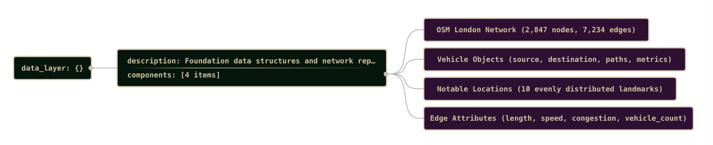
Phase 1 - Foundation & Network Setup
Real-World Data Integration [1]
• Implemented OSMnx for London street network extraction
• Successfully loaded City of London network: 2,847 nodes, 7,234 edges
Data Structure Design
• Created Vehicle class with comprehensive routing capabilities
• Implemented multigraph support for multiple roads between nodes
• Designed extensible architecture for algorithm comparison

Slide 4
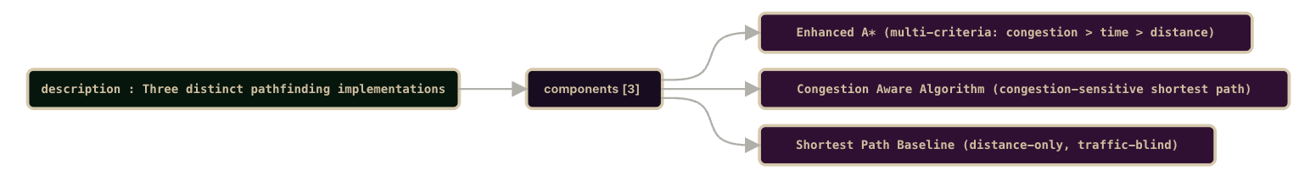
Phase 2 - Algorithm Development
Three Distinct Routing Algorithms Implemented
1. Enhanced A* Algorithm
• Purpose: Congestion-aware optimal pathfinding
• Innovation: Multi-criteria optimization (Congestion > Travel Time > Distance)
2. Congestion Aware Shortest Path Algorithm
• Purpose: Congestion-sensitive shortest path
• Guarantee: Optimal solution within congestion model constraints
3. Shortest Path Algorithm
• Purpose: Baseline comparison (distance-only)
• Characteristic: Consistent results regardless of traffic conditions

Slide 5

Phase 3 - Unified Travel Time System
Core Physics Formula [2]
Travel Time = Distance / Speed
Time (seconds) = Length (meters) / (Speed (km/h) × 1000/3600)
Congestion Penalty Model [3]
Light Traffic (1-2):
1.0-1.1x
(0-10% penalty)
Moderate Traffic (3-4):
1.1-1.3x
(10-30% penalty)
Heavy Traffic (5-6):
1.3-1.6x
(30-60% penalty)
Severe Traffic (7-8):
1.6-2.0x
(60-100% penalty)
Gridlock (9-10):
2.0-2.5x
(100-150% penalty, capped)

Slide 6
Small Roads (≤100m) - Gets crowded fast
Vehicles on Road | Congestion Level | Status
0-1 | 1 | 🟢 Clear
2--3 | 1.8 | 🟡 Getting busy
4--5 | 2.5 | 🟠 Congested
6--7 | 4.0-9.0 | 🔴 Heavy jam
8+ | 10 | ⛔ Gridlock
Major Roads (>300m) – High Capacity
Vehicles on Road | Congestion Level | Status
0-5 | 1 | 🟢 Clear
6-10 | 1.8 | 🟡 Getting busy
11-15 | 2.5 | 🟠 Congested
16-19 | 4.0-9.0 | 🔴 Heavy jam
20+ | 10 | ⛔ Gridlock
Medium Roads (100-300m) – Moderate Tolerance
Vehicles on Road | Congestion Level | Status
0-2 | 1 | 🟢 Clear
3-5 | 1.8 | 🟡 Getting busy
6-8 | 2.5 | 🟠 Congested
9-11 | 4.0-9.0 | 🔴 Heavy jam
12+ | 10 | ⛔ Gridlock

Slide 7
Phase 4 - MM1 Queuing Theory Integration [4]
Mathematical Foundation - Key Formulas:
Utilization Factor: ρ = λ/μ (arrival rate / service rate)
Average Vehicles in System: L = ρ/(1-ρ)
Average Time in System: W = 1/(μ(1-ρ))
Average Queue Length: Lq = ρ²/(1-ρ)
Service Rate Degradation Model:
degradation_factor = 0.1 + (0.4 × congestion_impact)
adjusted_service_rate = base_rate × (1.0 - degradation_factor + 0.1)

Slide 8
Phase 5 - Traffic Scenario Development
Five Traffic Scenarios Implemented:
Normal: 1.0-8.0 range, Baseline traffic flow
• Morning Rush: 3.0-8.0 range, Commuter patterns
• Evening Rush: 4.0-8.0 range, Peak congestion
• Weekend: 2.0-6.0 range, Lighter, distributed
• Special Events: 2.0-10.0 range, Variable intensity
Geographic Hotspot Algorithm:
Random hotspot placement within network bounds
Distance-based congestion falloff
Scenario-specific intensity multipliers

Slide 9
System Performance & Statistics
Network Statistics:
Total Nodes: 2,847
Total Edges: 7,234
Coverage Area: City of London, UK
Performance Metrics:
Route Calculation: <0.1 second average (for all algorithms)
Average A* Service Rate: 419.33 routes/second (Number of Routes it can iterate) *

Slide 10
Sample Iteration

Slide 11
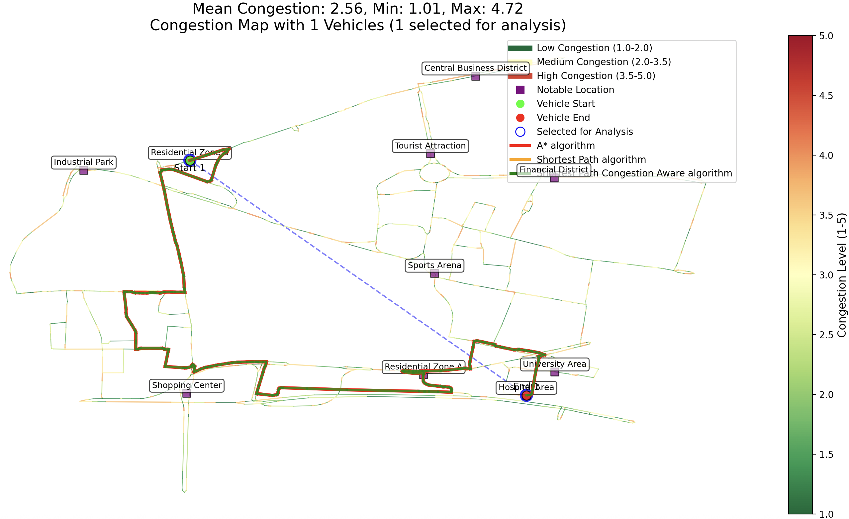

Slide 12
Stress Testing Results
Sample Stress Test: (A) Residential Zone B → (B) Hospital Area
# of iterations: 10+
# of vehicles added on each iteration: 20
GRAPH ON NEXT PAGE
Key Findings:
A* demonstrates adaptive routing under stress
Realistic Travel Time Increase
Congestion penalties remain within realistic bounds
During Testing system maintains stability with 200+ vehicles

Slide 16
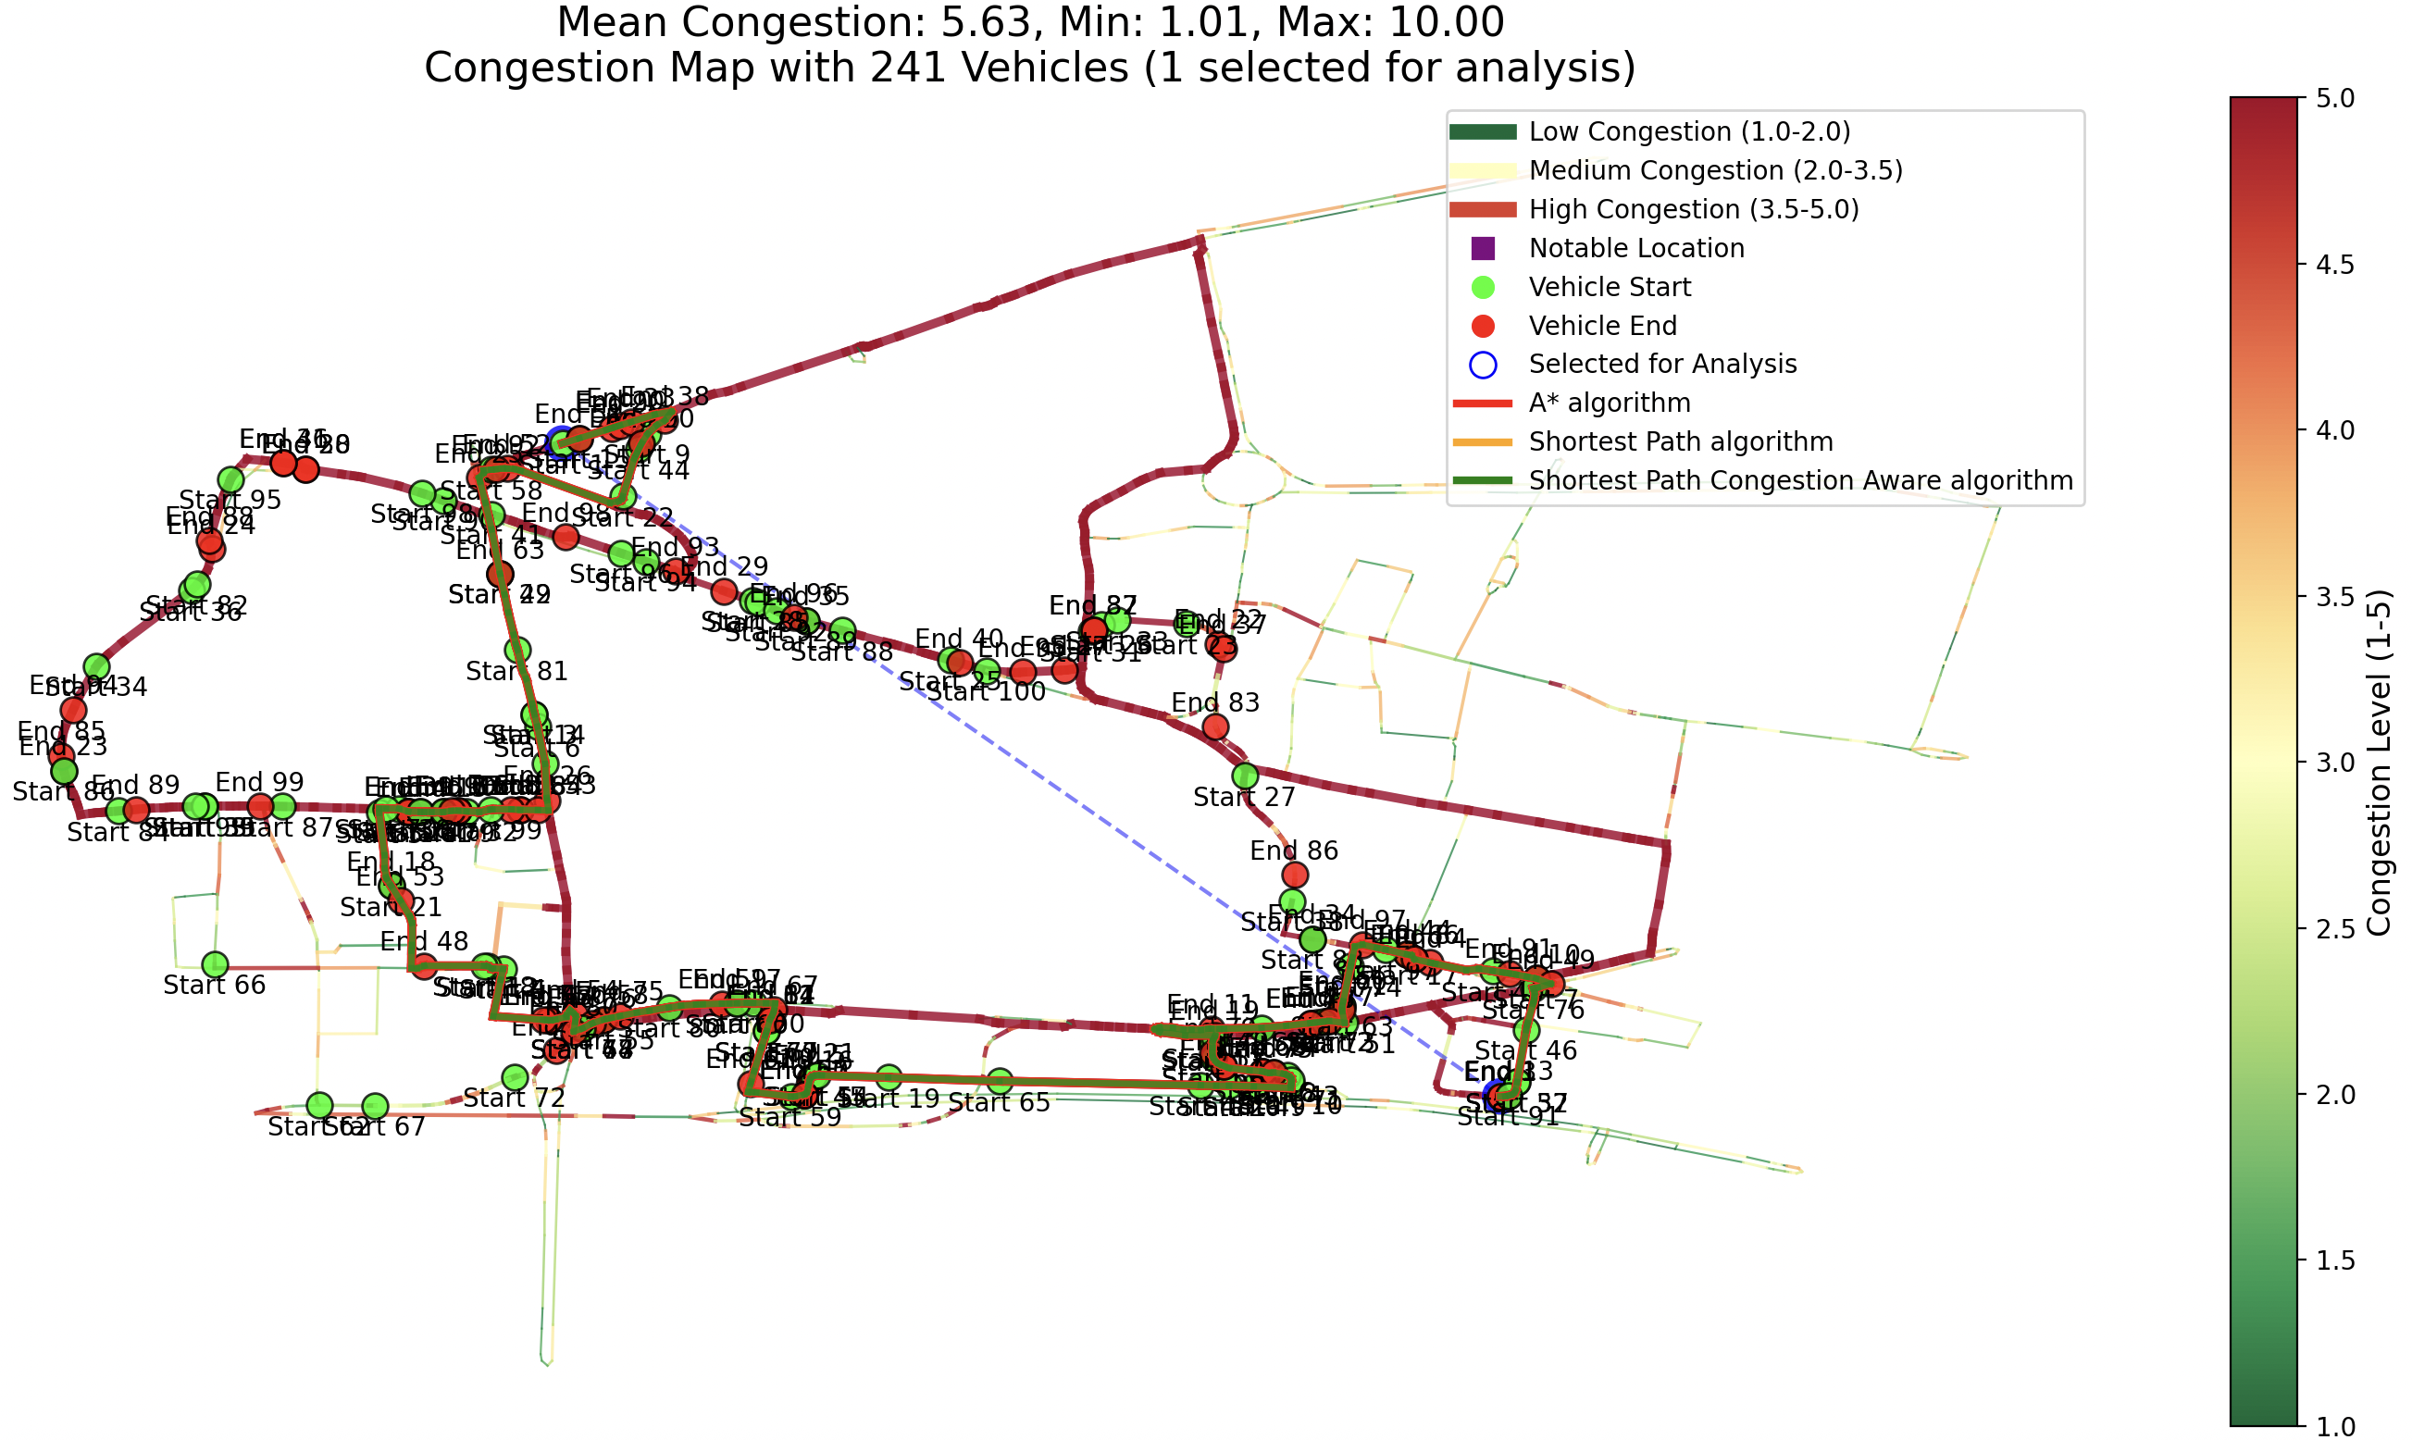

Slide 17
Technical Achievements & Innovations
1. Unified Travel Time System
Problem Solved: Eliminated double-penalty issues (initial Code)
Innovation: Single source of truth for all calculations
2. Multi-Criteria A* Implementation
Enhancement: Beyond traditional distance-only A*
Priority: Congestion → Travel Time → Distance
3. Dynamic Congestion Modeling
Integration: MM1 queuing with real-time vehicle tracking
Validation: Service rate degradation analysis

Slide 18
System Validation & Quality Assurance
Travel Time Realism Check:
• London Speed Range: 8-40 km/h [5]
• Average Simulation Speed: 16.64 km/h (realistic for urban) – City Center [5]
Congestion Model Validation:
• Penalty Caps: Maximum 2.5× multiplier enforced
• Service Rate Bounds: Minimum 50% capacity maintained
• Queue Stability: MM1 model prevents infinite queues [4]

Slide 19
Academic Contributions
Novel Contributions:
1. Unified Travel Time Framework
• Eliminates calculation inconsistencies in routing research
• Transferable to other traffic simulation projects
2. Integrated MM1-Routing System
• Real-time queuing theory integration with pathfinding
• More realistic traffic flow modeling
3. Comprehensive Evaluation Framework
• Multi-metric algorithm comparison system
• Professional analysis suitable for publication

Slide 20
System Architecture Overview
Core Components:
Routing Algorithms: A*, Congestion Aware SP, Shortest Path
• Congestion Modeling: MM1 Queue, Dynamic Updates
• Vehicle Management: Smart Placement, Impact Tracking
• Data Models: OSM Integration, Unified Calculations
• Analysis Tools: Excel Reports, Statistical Analysis
• Visualization: Interactive Maps, Multi-Route Display
Key Statistics:
• Total Lines of Code: ~3,500 LOC
• Core Modules: 9 main files
• Functions Implemented: 127 functions

Slide 21
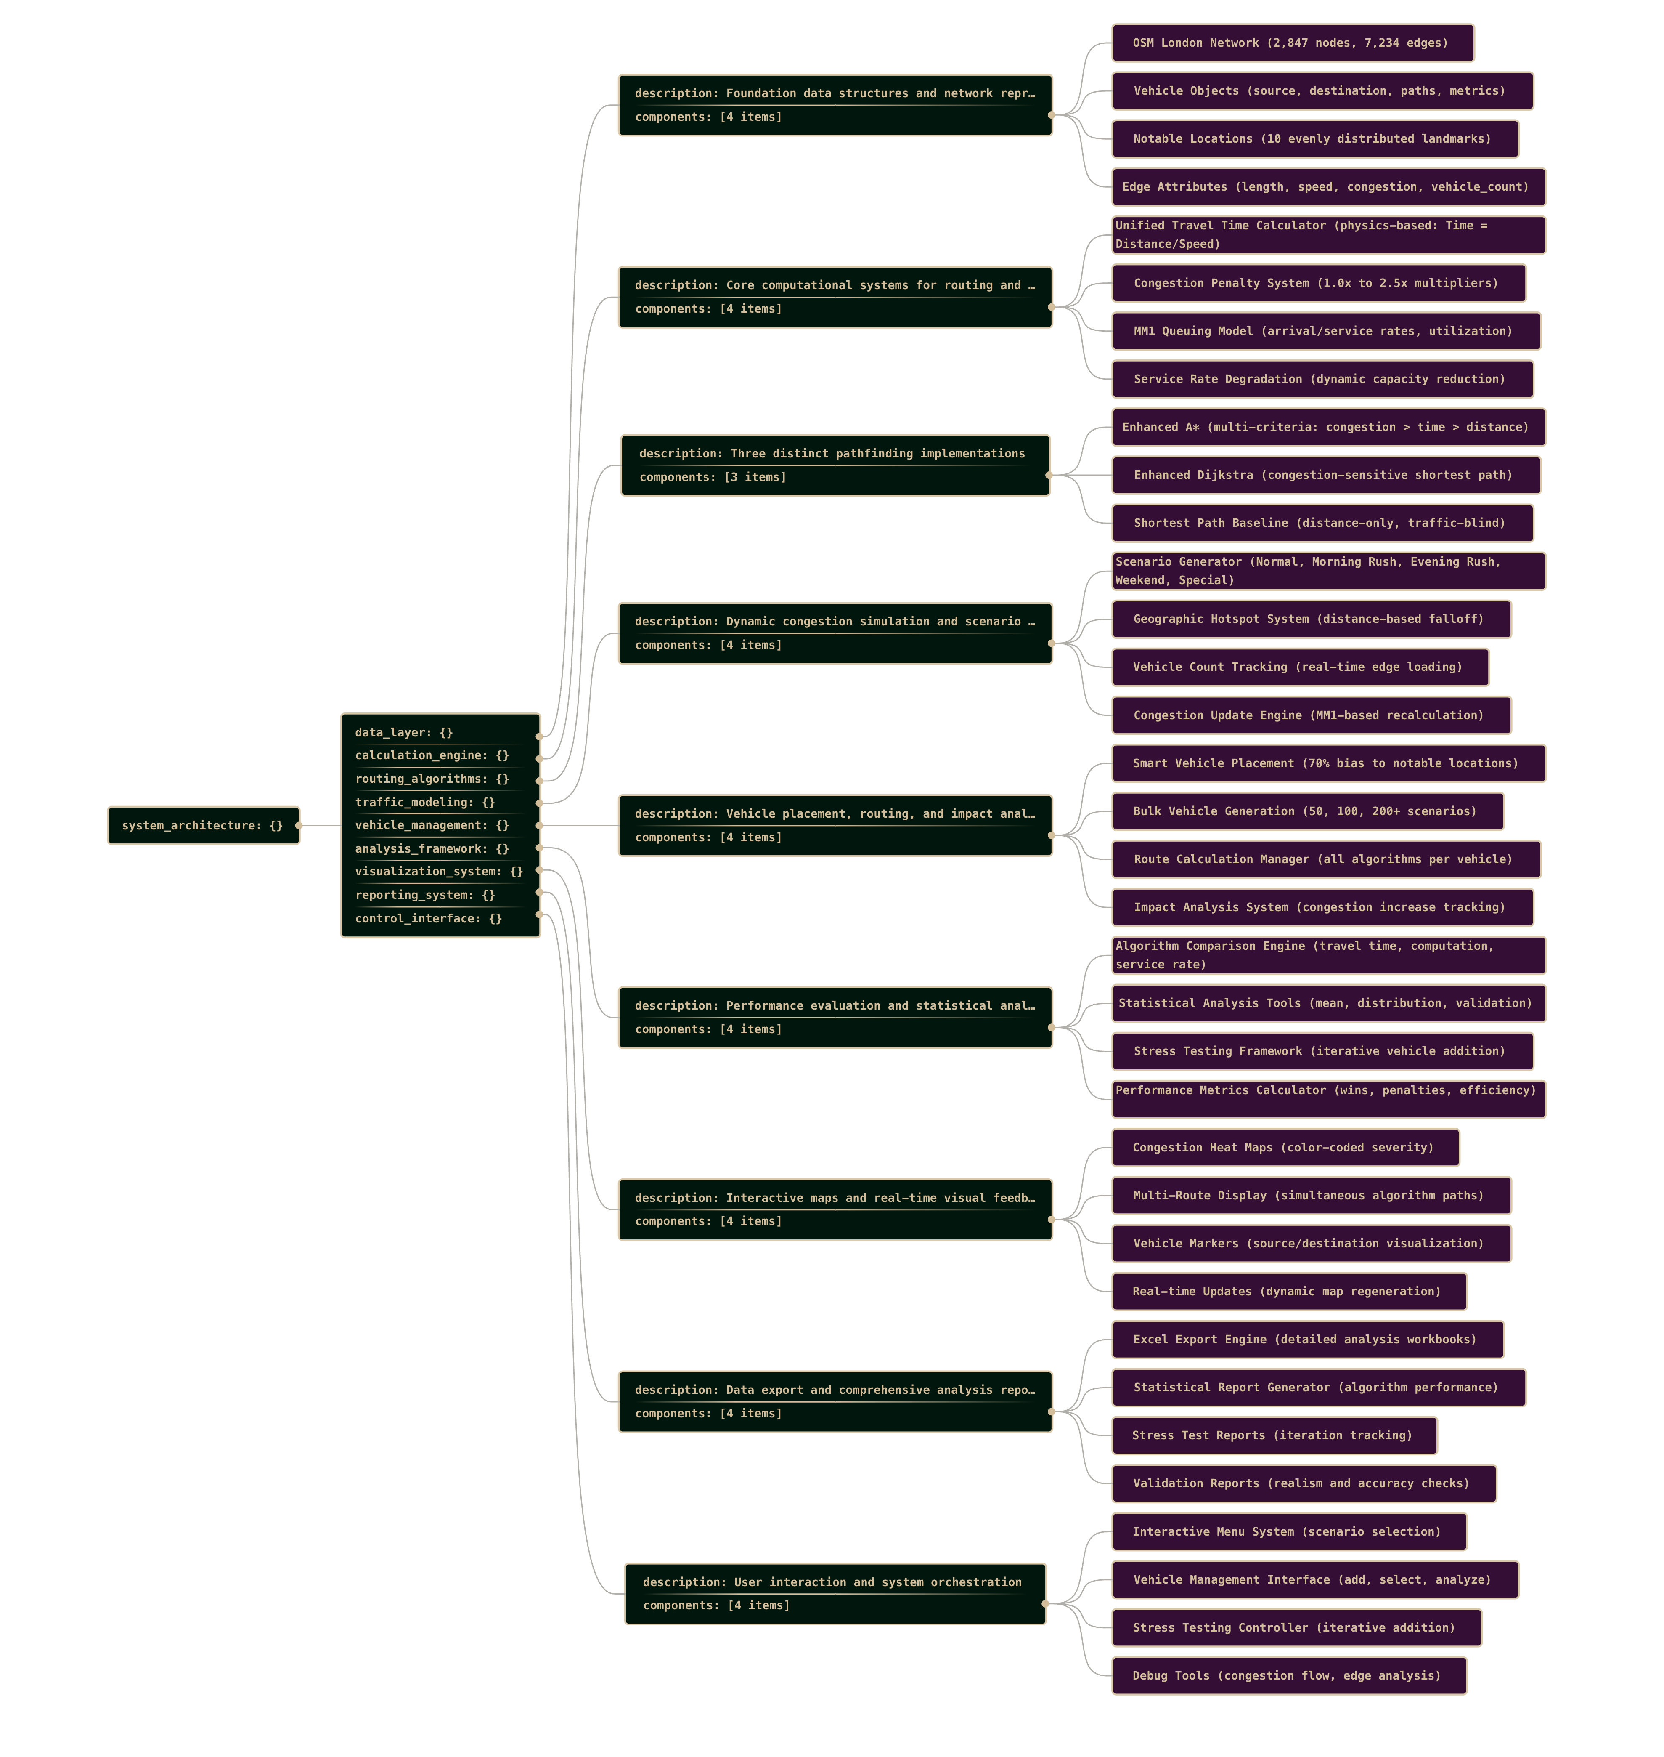

Slide 22
Final Summary & Conclusion
Key Achievements:
Technical Excellence:
• Robust, scalable traffic simulation system
• Real-world (Simulated) data integration and validation
• Advanced mathematical modeling (MM1 queuing)
Research Impact:
• Demonstrated A* superiority in congested environments
• Validated queuing theory integration with routing
• Created reusable framework for algorithm comparison
PROJECT STATUS: READY TO START MACHINE LEARNING TO DECREASE COMPUTATION TIME AND INCREASE ACCURACY

Slide 23
References
[1] Fu, X., Kakkar, D., Chen, J., Moynihan, K. M., Hegland, T. A., & Blossom, J. (2023). A Comparative Study of Methods for Drive Time Estimation on Geospatial Big Data: a Case Study in USA. The International Archives of the Photogrammetry, Remote Sensing and Spatial Information Sciences, 48.
[2] Flügel, S. et al. (2022). Value of travel time by road type. European Transport Research Review, 14(1).
[3] Christidis, P., & Rivas, J. N. I. (2012). Measuring road congestion. Institute for Prospective Technological Studies (IPTS), European Commission Joint Research Centre.
[4] Pedramhajipour, L. M., & Keshavarzi, M. R. (2011). Measurements and comparative of M/M/1 and M/D/1 queuing models of resource management in satellite systems. Journal of Convergence Information Technology, 6(5), 99-107.
[5] Steinbach, R., Grundy, C., Edwards, P., Wilkinson, P., & Green, J. (2011). The impact of 20 mph traffic speed zones on inequalities in road casualties in London. J Epidemiol Community Health, 65(10), 921-926.

